Slide 1

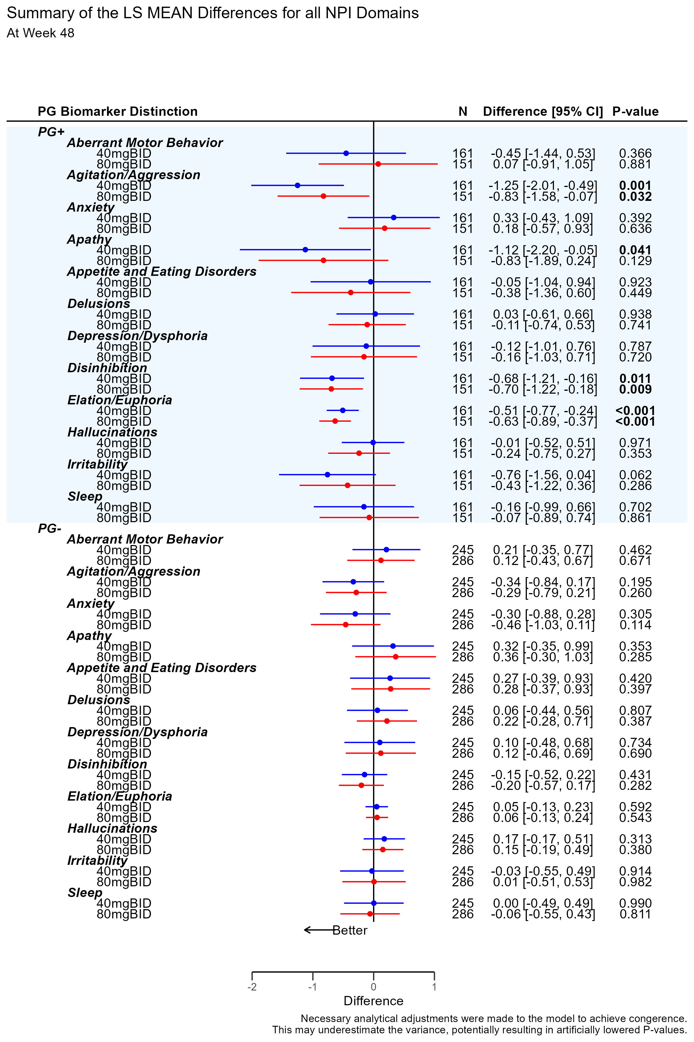
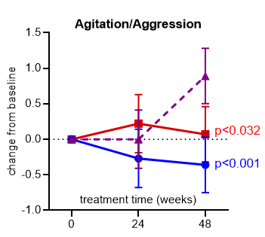
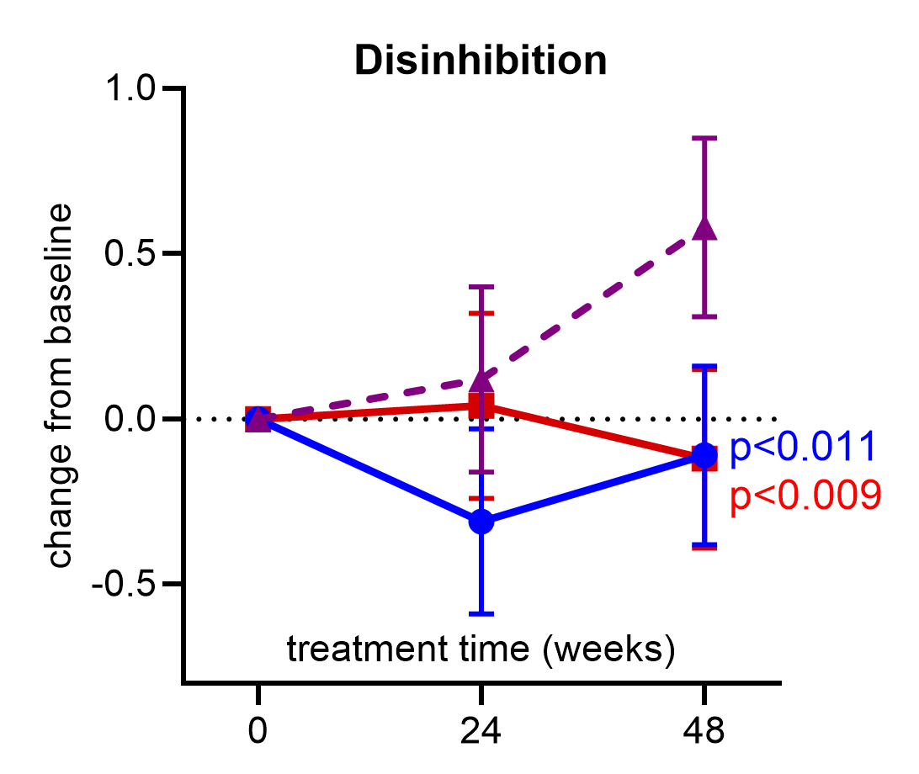
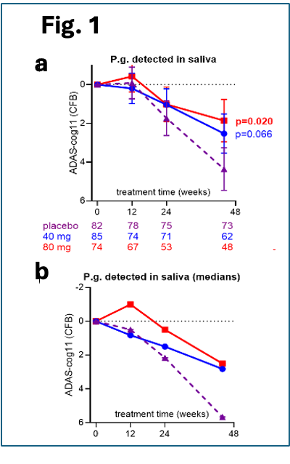
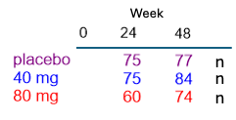
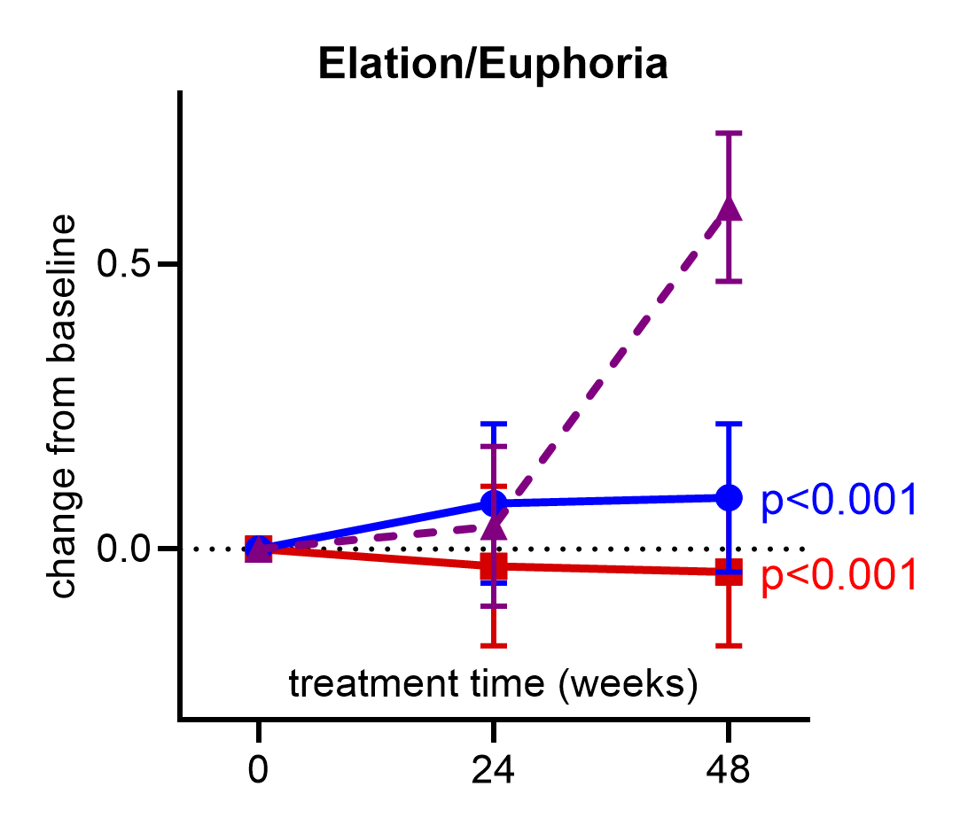
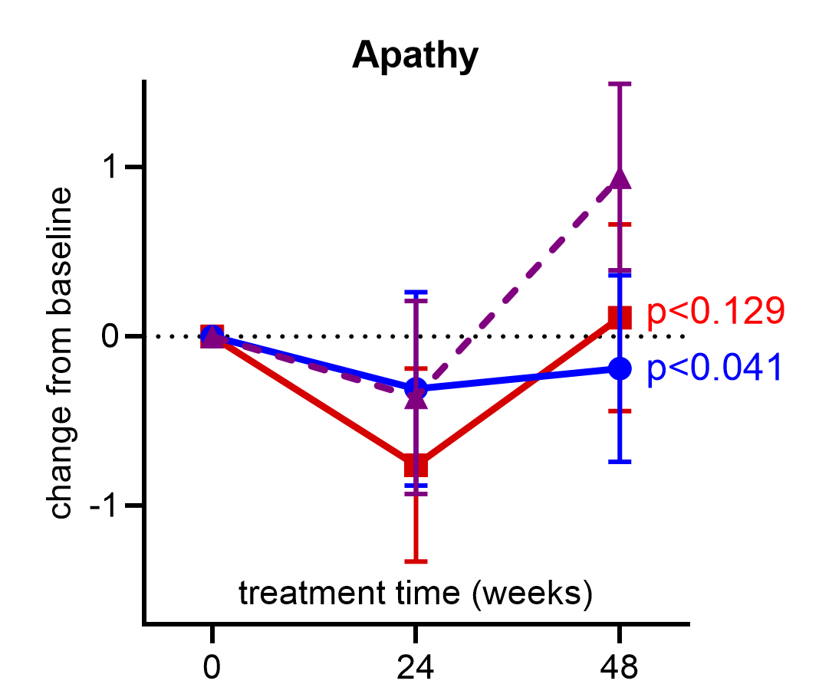
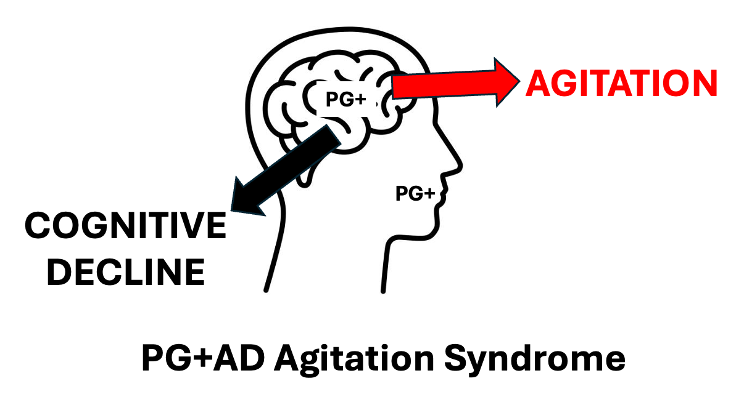
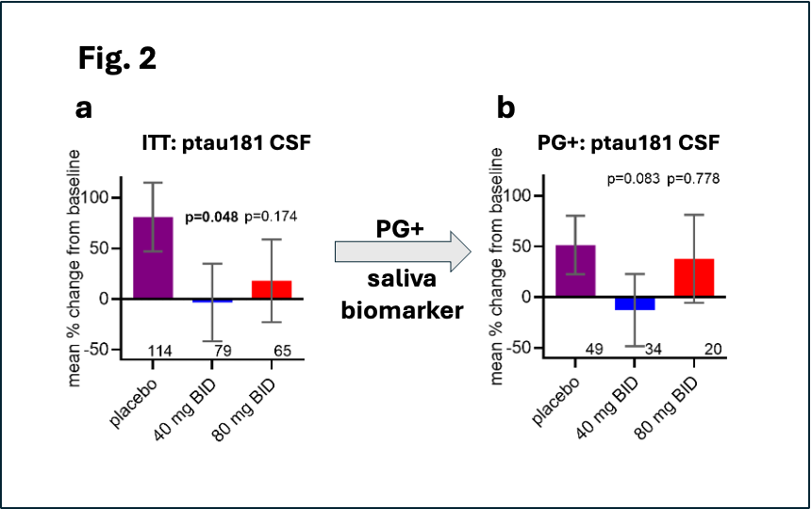
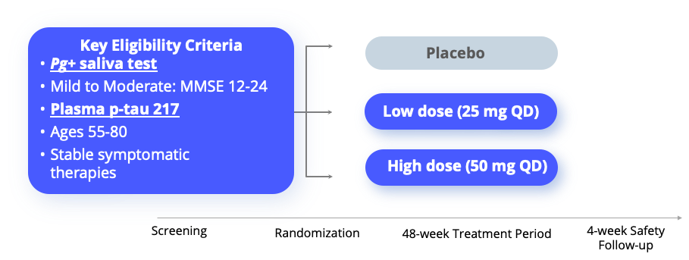

The Phase 2/3 GAIN Trial of the first-generation P. gingivalis gingipain inhibitor atuzaginstat in mild-to-moderate probable AD: New CSF Biomarker Data and Neuropsychiatric Outcomes
Michael Detke, MD PhD¹, Marwan Sabbagh, MD², Joanna Bolger¹, Mark Ryder, DMD³, Craig Mallinckrodt, PhD⁴, Florian Ermini, PhD¹, Casey Lynch¹, Stephen Dominy, MD¹
(1) Lighthouse Pharmaceuticals, Novato, CA; (2) Barrow Neurological Institute, Phoenix, AZ; (3) Stanford University, Stanford, CA; (4) Pentara Corp, Millcreek, UT.
Abstract
NPI Subdomain analysis in PG+ and PG- populations
NPI treatment effects in PG+ population
We present CSF AD biomarker data from the GAIN trial¹ that shows an effect of atuzaginstat on CSF pTau181. CSF pTau181 levels have been shown by others to correlate with total score on the Cohen-Mansfield Agitation Inventory (CMAI)^{2,3}. Using the Neuropsychiatric Inventory (NPI), we demonstrate an effect of atuzaginstat on a cluster of neuropsychiatric symptoms, including agitation, in subjects with mild-moderate dementia and P. gingivalis-positive saliva (PG+).
Fig. 3
The 12 Subdomains of the NPI. The PG+ group shows
benefit in multiple domains, whereas PG- shows no benefit.
Fig. 4
Analysis of atuzaginstat treatment effect reveals a cluster of neuropsychiatric sx including agitation.
a
a
b
Atuzaginstat slowed cognitive decline in prespecified PG+ AD subgroup in the Phase 2/3 GAIN trial
Seminal
Discovery
Background: In the phase 2/3 GAIN trial of the P. gingivalis (Pg) gingipain inhibitor atuzaginstat in mild-moderate AD dementia,
the prespecified subgroup analysis demonstrated efficacy in patients with Pg-positive saliva (PG+), slowing cognitive decline on the ADAS-Cog11 by 57% (p= 0.020, N=244) (Fig. 1)¹.
An exploratory analysis of the effect of atuzaginstat on AD CSF biomarkers, including pTau181, was prespecified. In addition, the NPI-12 was prespecified as a secondary endpoint, allowing us to determine if atuzaginstat had an effect on both CSF pTau181 levels and the NPI agitation subdomain.
Focusing on treating agitation is important because it is a major cause of caregiver distress and patient long-term care placement. However, no disease modifying treatment has been approved for the treatment of AD agitation.
Methods: The Phase 2/3 GAIN study was a 3-arm RCT in 643 subjects with baseline MMSE of 12-24 randomized to one of two doses of atuzaginstat (40mg or 80mg BID) or placebo for 48 weeks. CSF was collected at baseline and end of study in a subset of patients. The NPI-12 was administered at baseline and weeks 24 and 48. New post-hoc analyses were conducted to evaluate the effect of both doses of atuzaginstat on the 12 NPI subdomains using a MMRM analysis. PG+ and PG- groups were analyzed separately.
ADAS-Cog11 PG+.
c
d
b
Conclusions:
LHP588 Phase 2 SPRING Trial: 300 patients with PG+AD with focus on treating cognitive decline and agitation
LHP588 Phase 2 SPRING Trial: 300 patients with PG+AD with focus on treating cognitive decline and agitation
Results:
Evidence that atuzaginstat blocked increase of CSF pTau181, a biomarker of AD agitation (CMAI)
Effect of atuzaginstat on longitudinal increase of CSF pTau181 over 48 weeks.
LHP588: New structure, same MOA as atuzaginstat. Potent, once daily dosing,
well tolerated in Phase 1 supporting safety. www.springclinicaltrial.com
Endpoints
Primary: ADAS-Cog11
Secondaries: CDR-SB, ADCS-ADL, MMSE, CMAI to measure agitation for Regulatory pathway
Primary disease biomarker: Whole brain volume MRI
Biomarkers: Pg in Saliva, Anti-Pg IgG in serum, plasma p-tau 217
C
Low dose (25 mg QD)
1. Detke MJ, et al., AD/PD Conference 2022; Mar 23:
https://www.vidementia.com/video/tivmocixwx0
2. Bloniecki et al., Agitation in dementia: relation to core cerebrospinal fluid biomarker levels. Dement Geriatr Cogn Dis Extra. 2014
3. Hendrix et al., Cohen-mansfield agitation inventory total score as a measure of agitation and aggression in Alzheimer's disease: A factor analysis. Int Psychogeriatr. 2025
©Lighthouse Pharmaceuticals- Proprietary & Confidential

